Slide 1
COMP90054 AI Planning for Autonomy
Workshop4

Slide 2
Objectives:
1. Properties of Heuristic Functions
2. Execution of Heuristic Search Algorithms

Slide 3
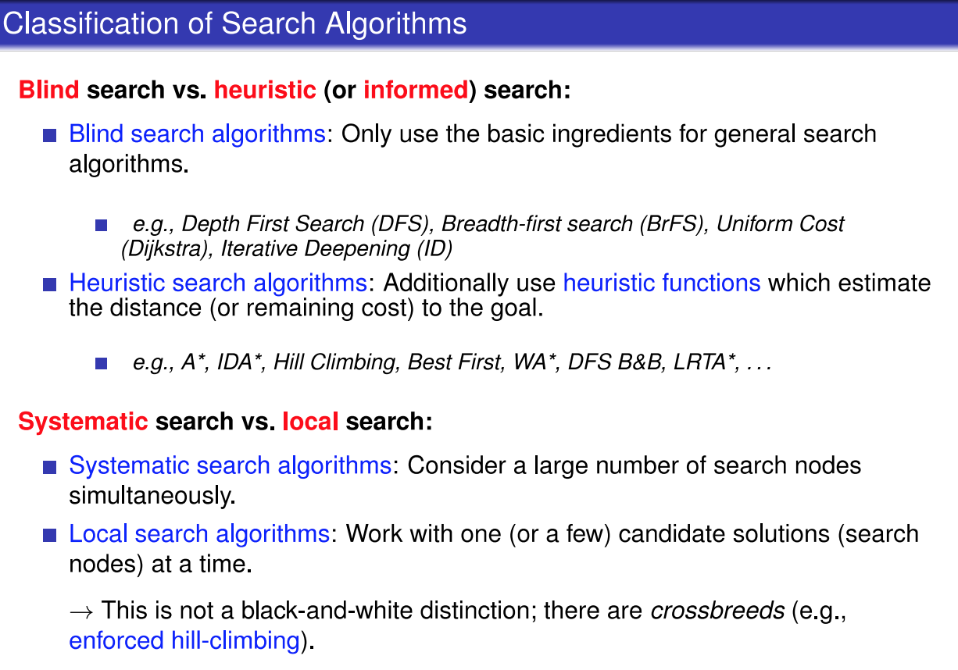

Slide 4
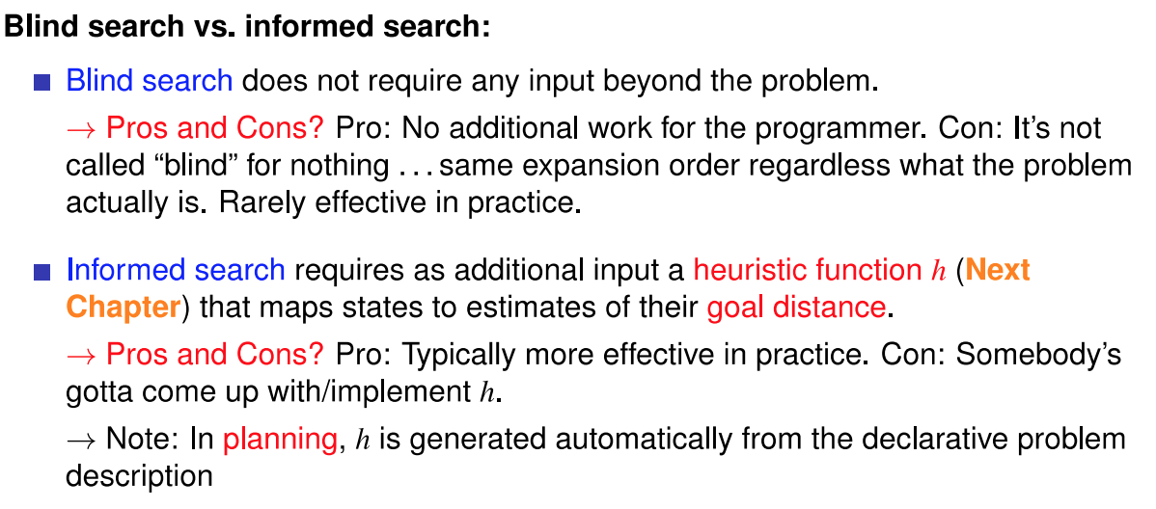

Slide 5
Heuristic Function
Heuristic searches require a heuristic function to estimate remaining cost.
Its value h(s) for a state s is referred to as the state’s heuristic value, or h-value
Remaining Cost (h∗) : is the cost of an optimal plan for s, or ∞ if there exists no plan for s, it is the perfect heuristic for a planning task

Slide 6
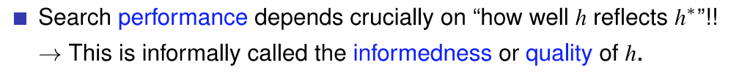
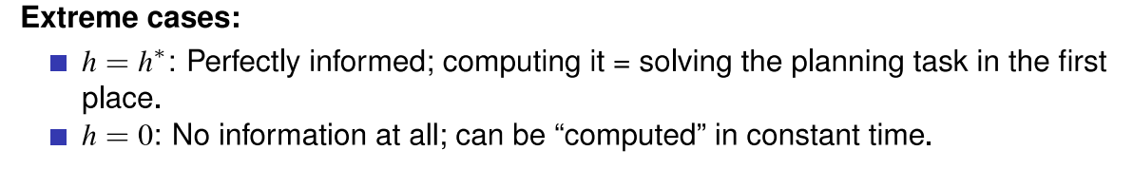

Slide 7
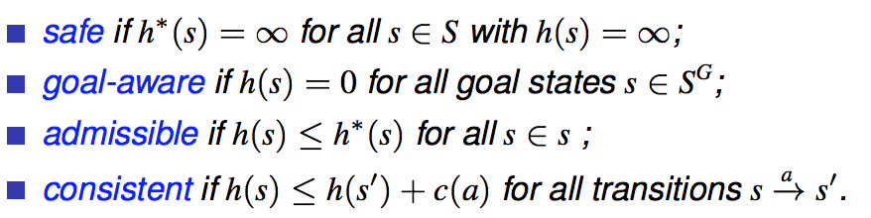
Properties of Heuristic Functions
consistent
goal-aware
admissible
goal-aware
safe

Slide 8
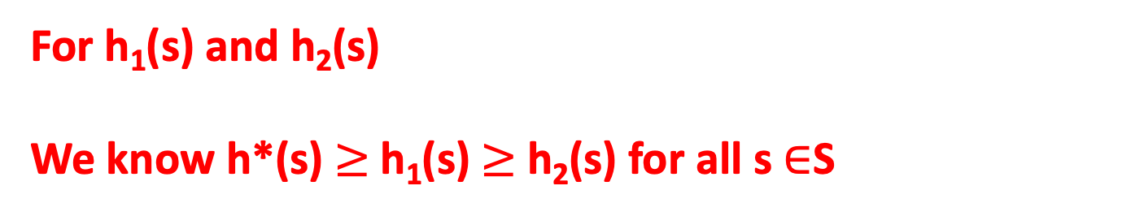
Dominate between two heuristics
For h₁(s) and h₂(s)
We know h*(s) $≥$h₁(s) $≥$h₂(s) for all s $∈$S

Slide 9
Data Structure: priority queue
ordered by f(s) value
A*
Weighted A* (WA*)
Greedy Best-First Search
f (s)= g(n) + h(s)
f(s) = g(n) + w*h(s)
f(s) = h(s)
f-value is used in priority queue
g-value is the accumulated cost from initial state to current state
h-value is the heuristic value of that state

Slide 10
Heuristic Search Algorithms :
Additionally use heuristic functions which estimate the distance (or remaining cost) to the goal.
A*
WA*
Enforced hill-climbing
Greedy Best First Search
Most popular algorithm in optimal planning
3 most popular algorithms in satisficing planning
If h is admissible, then we can guarantee the solution found by A* (that includes reopen in algorithm) is optimal
If h is admissible and consistent, then we can guarantee the solution found by A* (that didn’t include reopen) is optimal

Slide 11
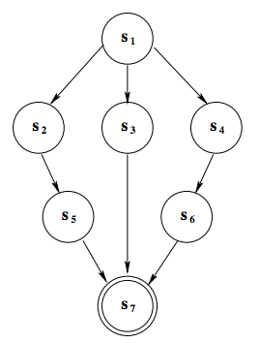
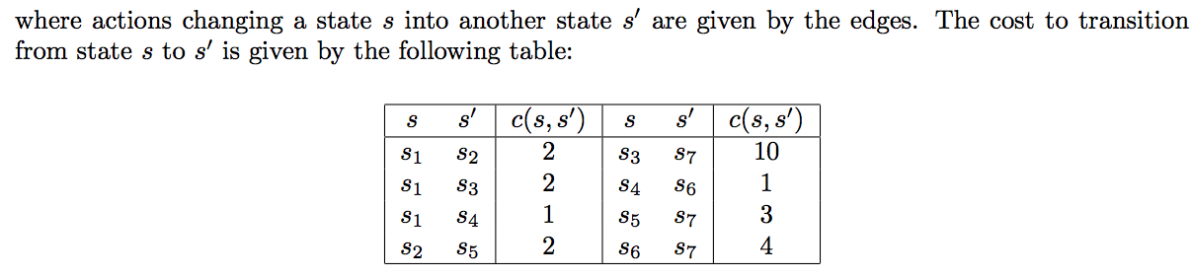
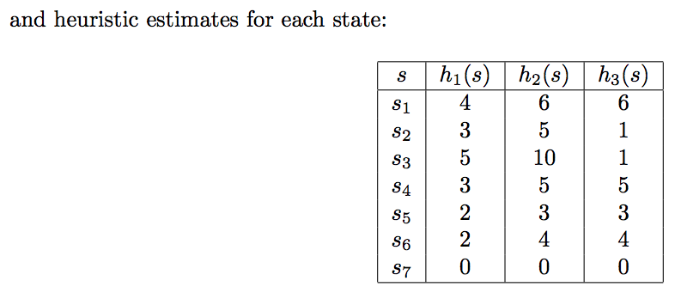
2
2
1
2
1
10
3
4

Slide 12

Question 1

Slide 13
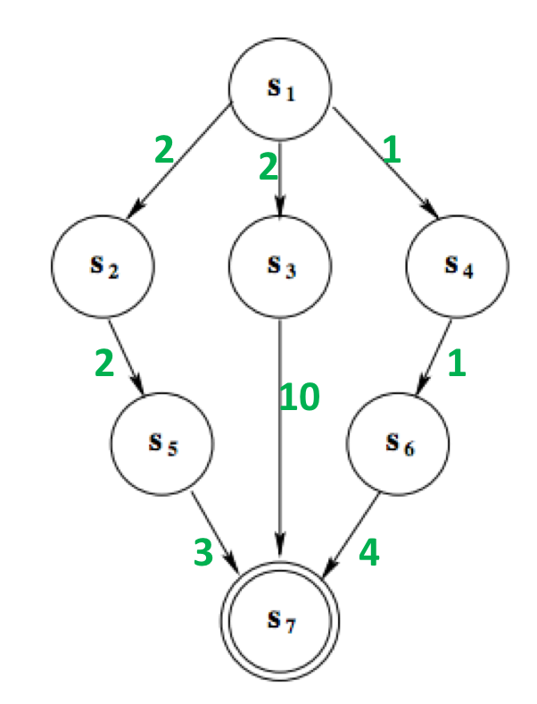


Calculate h*
s
h*(s)

Slide 14
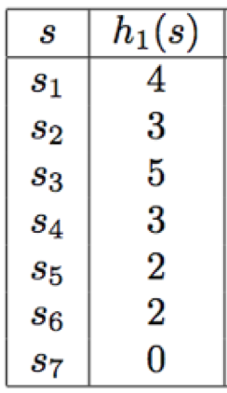
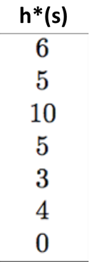



Question 1-1
<=
<=
<=
<=
<=
<=
<=
<=
<=
<=
<=
<=
<=
<=
<=
<=
<=
<=
<=
<=
<=
So, h1 is admissible
So, h2 is admissible
So, h3 is admissible

Slide 15
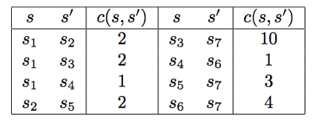
Question 1-2
Which heuristics are consistent?
4
h(s1) h(s2) + c(s1, s2)
2
1
<=
2
3
5
3
4
3
2
2
1
10
h(s1) h(s3) + c(s1, s3)
<=
2
2
3
4
4
5
2
and so on… …
0
So h1 is consistent

Slide 16
h2 is also consistent

Slide 17
h(s1) h(s2) + c(s1, s2)
>
6
1
2
So h3 is not consistent

Slide 18
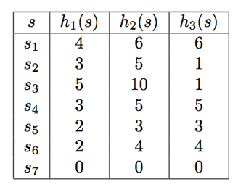
Question 1-3
Does any heuristic dominate any other?
h* dominates all other admissible heuristics
h2 = h* and therefore dominates all other admissible heuristics.
h1(s1) < h3(s1) and h3(s2) < h1(s2) and therefore neither of h1 and h3 dominate each other

Slide 19
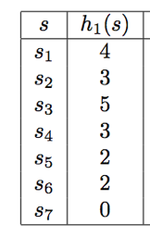
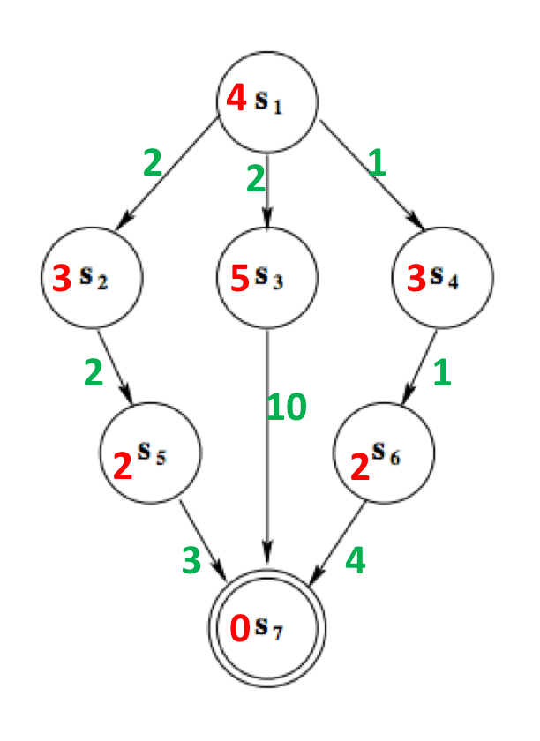
1.A*
Priority Queue ordered by f (s)= g(s) + h(s)
 | Iteration1 | Iteration2 | Iteration3
OPEN | n0=<S1,0,4,null> | n1=<s2,2,5,n0> n2=<s3,2,7,n0,> n3=<s4,1,4,n0,> | n5=<s6,2,4,n3> n1=<s2,2,5,n0> n2=<s3,2,7,n0,>
CLOSED |  | n0 | n0 n3

Slide 20
1.A*
Priority Queue ordered by f (s)= g(s) + h(s)
 | Iteration4 | Iteration5
OPEN | n6=<s7,6,6,n4> n1=<s2,2,5,n0> n2=<s3,2,7,n0,> | n6=<s7,6,6,n4> n2=<s3,2,7,n0,> n4=<s5,4,6,n1,>
CLOSED | n0 n3 n5 | n0 n3 n5 n1
Solution found by A* is : s1 → s4→ s6 →s7
This solution is optimal
Since n6 is at a goal state and has the lowest admissible cost of any node in the open list
All other paths from any other open node must be longer.

Slide 21
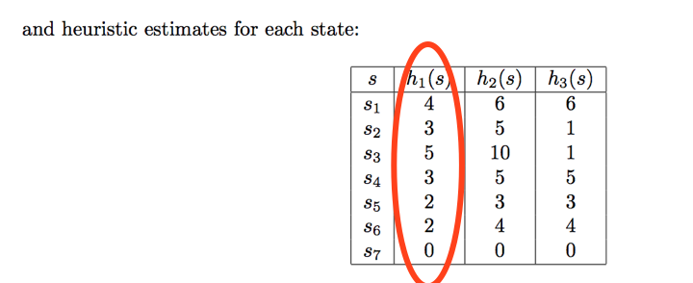
A* h1
2
2
1
2
1
10
 | Iteration 1 | Iteration 2 | Iteration 3 | Iteration 4
OPEN
CLOSED
3
4
h1 is admissible and consistent
no reopen

Slide 22
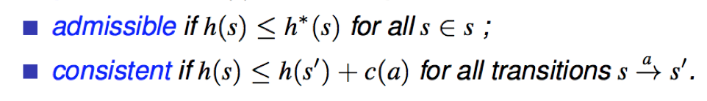
Reopen in A*
s1
4
1
3
s2
1
s3
7
3
10
admissible but not consistent
reopen
s4
0

Slide 23
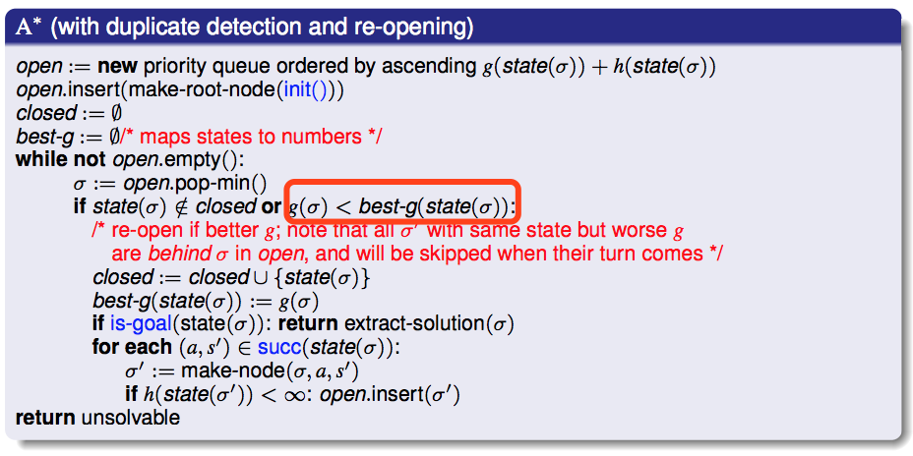
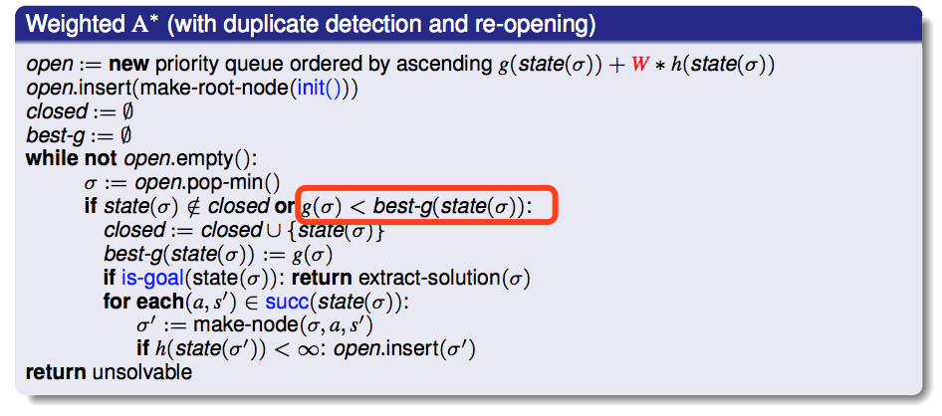
WA*， A* may have reopen
Greedy Best First Search doesn‘t have

Slide 24
Solution 1: Find the distance to closest unvisited goal
Admissible and consistent
Complexity of computing h: O(g)
Notes:
3

Slide 25
Solution 2: Find the distance to farthest unvisited goal
Admissible and consistent
Complexity of computing h: O(g)
Notes:
5

Slide 26
Solution 3: sum of distance to each unvisited goal
Not Admissible
Not consistent
Complexity of computing h: O(g)
Notes:
5+3=8 > 7
8 – 4 = 4 > actual cost 3

Slide 27
Solution 4: all zero
h(s) = 0 for all s
Admissible and consistent
But provide no information at all
Bad heuristic function
Complexity of computing h: O(1)

Slide 28
Solution 5:
h(s) = goal counting
Goal counting is not admissible, not consistent
Complexity of computing h: O(g)

Slide 29
Solution 7: Minimum Spanning Tree
hMST= 10
h*= 11
Admissible but not consistent

Slide 30
Dominate?
h_{mst} dominates h_{farthest} dominates h_{closest}
h_{mst} dominates h_{goal-counting}

